Slide 1
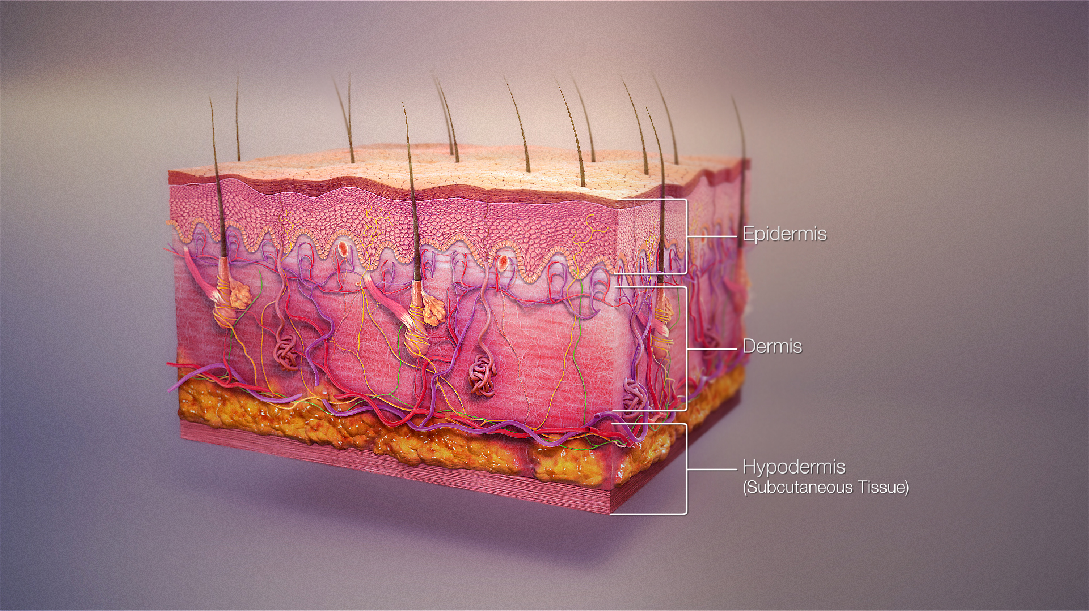
Skin app

Slide 2
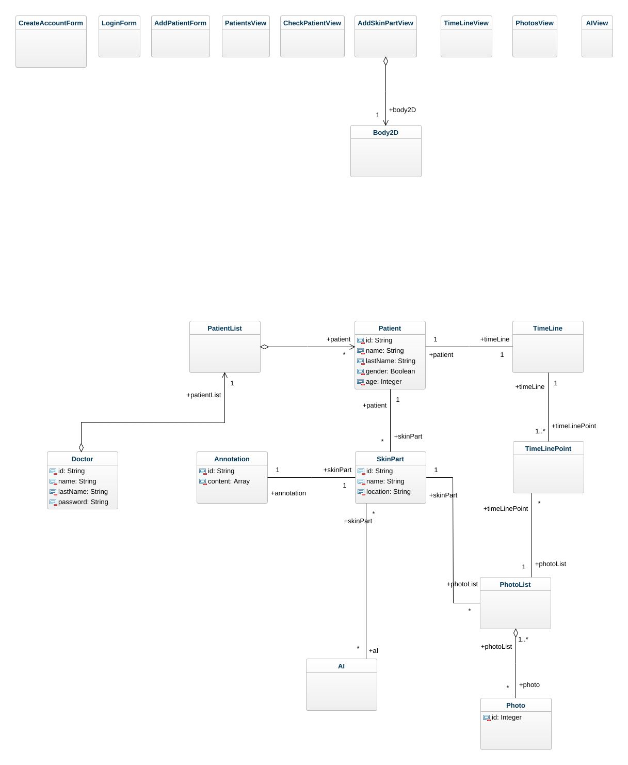
Class diagram

Slide 3
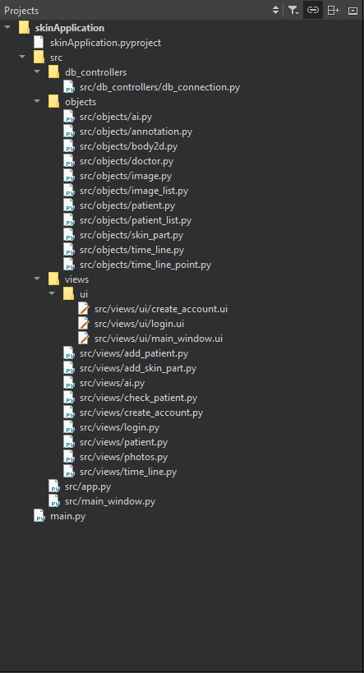
Project files structure

Slide 4
Create account
Name
Last name
Password
Repeat password
Email
Create
Notes:
Account creation for doctors

Slide 5
Login
Name
Agustin CARTAYA
Password
*****
Forgot password
Login
Notes:
Login for doctors

Slide 6

List of patients
Add new patient
ID: 34AD
Organizer
Filters
A-z
Z-A
ID
Name
CLINICAL ATTRIBUTES
Gender
ID: 34AD
ID: 27AD
ID: 3444
ID: 34AO
M
F
Age
Precise
Ej: 36
Rangue
ID: 34BD
ID: 87D6
ID: 348D
ID: 34P4
0-20
20-50
50+
DIAGNOSTIC ATTRIBUTES
Bening (120/300)
Malignant (150/300)
1
Of 300
Indeterminate (30/300)

Slide 7
Add patient
Name
Last name
Age
Gender
M
F
Create

Slide 8
Check patient
Export patient data
Patient ID: 34AD
Parts of the skin under study
Patient ID: 34AD
Name: | Agustin
Last Name: | CARTAYA
Gender | Male
Age | 21
Add
Medical information
Notes:
More oprions: export data in PDF
AI Results: Will show the IA with the more accurate result

Slide 9


Check patient
Export patient data
Patient ID: 34AD
Patient ID: 34AD
Parts of the skin under study
Name: | Agustin
Last Name: | CARTAYA
Gender | Male
Age | 21
Annotations
Risk: BENIGN
Type: Mole
Notes: ….
Read more
AI Results
Type IA: IA - 1
Risk: BENIGN
Type: Mole
Accurance: 93%
See other IA results
See Timeline
See Images
Ear
More options
Update
Annotations
Risk: MALIGNANT
Type: Melanoma
Notes: ….
Read more
AI Results
Type IA: IA - 3
Risk: MALIGNANT
Type: Melanoma
Accurance: 87%
See other IA results
See Timeline
See Images
Back
More options
Medical information
Update
Add
Notes:
More oprions: export data in PDF
AI Results: Will show the IA with the more accurate result

Slide 10






Add body part
Completed
Annotations
Risk | INDETERMINATE
Type | …
Other annotatios
Notes:
Add images
See images
Launch AI
AI-1
AI-2
AI-3
AI-4
Description
……
….
………
Results
Risk: MALIGNANT
Type: Melanoma
Accurance: 87%
Description
……
….
………
Description
……
….
………
l
+

Slide 11
Time line
Location: Ear | Patient ID: 34AD | Name: Agustin | Last name: CARTAYA
27 - 04 - 2013
27 - 04 - 2013
27 - 04 - 2013
27 - 04 - 2013
27 - 04 - 2013
Annotations
Medecin: François DUPONT
Risk: BENIGN
Type: Mole
Notes: ….
Read more
AI Results
Type IA: IA – 1 Risk: BENIGN Type: Mole Accurance: 84% Read more | Type IA: IA – 2 Risk: BENIGN Type: Mole Accurance: 91% Read more | Type IA: IA – 3 Risk: BENIGN Type: Mole Accurance: 93% Read more
Images
Photos
Dermatoscope
Microscopy

Slide 12
Photos
Filters
Organizer
Type
Date
Name
A-z
Z-A
Photo (120/300)
Dermatology (150/300)
IMG 1
IMG 1
IMG 1
IMG 1
IMG 1
Microscopy (30/300)
Description
Type: Microscopy
Name: PH-01
Date: 27 - 04 – 2021
Depth: 22.2 mm
IMG 1
IMG 1
IMG 1
IMG 1
IMG 1
Preview
IMG 1
IMG 1
IMG 1
IMG 1
IMG 1
1
Of 300

Slide 13
AI - 1
About AI - 1
Location: Ear | Patient ID: 34AD | Name: Agustin | Last name: CARTAYA
Information required
Images to use
Photos
Dermatoscope
Microscopy
Add
Add
Add
Calculate

